Slide 1
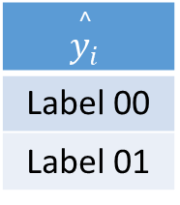
Y | f_{SM}
Label 00 | 0.88
Label 01 | 0.71
Label 02 | 0.50
Label 03 | 0.21
Label 04 | 0.11
Label 05 | 0.46
$$\overset{^}{y_{i}}$$
Label 00
Label 01

